Slide 1
Structures and File System
UNIT V
By
Prof. Amruta Hingmire

Slide 2
Structures
Structure is a user-defined datatype in C language which allows us to combine data of different types together
Structure is a group of variables of different data types represented by a single name
It is somewhat similar to an Array, but an array holds data of similar type only. But structure on the other hand, can store data of any type, which is practical more useful.

Slide 3
Why Structures?
We need to store the data of students like student name, age, address, id etc. One way of doing this would be creating a different variable for each attribute, however when you need to store the data of multiple students then in that case, you would need to create these several variables again for each student.

Slide 4
Structures
Structures are used to represent a record. Suppose you want to keep track of your books in a library.
You might want to track the following attributes about each book −
Title
Author
Subject
Book ID

Slide 5
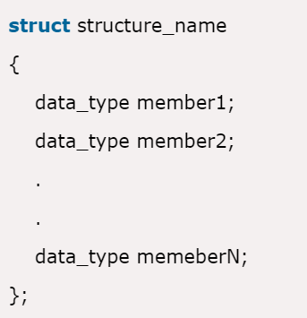
Defining a Structure
To define a structure, you must use the struct statement. The struct statement defines a new data type, with more than one member.
The format of the struct statement is as follows

Slide 6
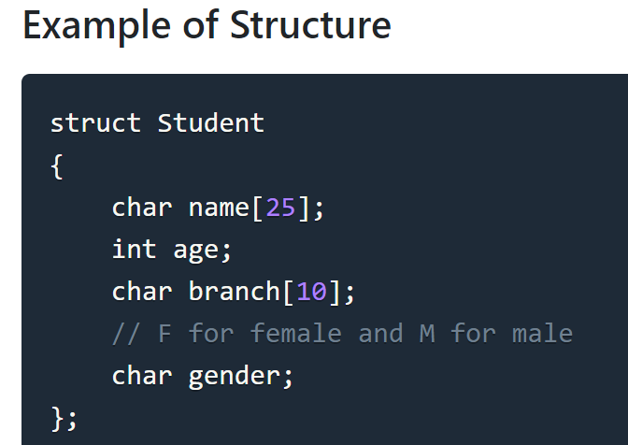
Defining a Structure
Here struct Student declares a structure to hold the details of a student which consists of 4 data fields, namely name, age, branch and gender. These fields are called structure elements or members.

Slide 7
Defining a Structure
Each member can have different datatype, like in this case, name is an array of char type and age is of int type etc. Student is the name of the structure and is called as the structure tag.

Slide 8
Declaring Structure Variables
It is possible to declare variables of a structure, either along with structure definition or after the structure is defined

Slide 9
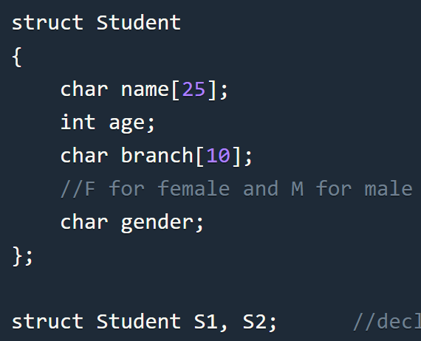
1) Declaring Structure variables separately
Here S1 and S2 are variables of structure Student.

Slide 10
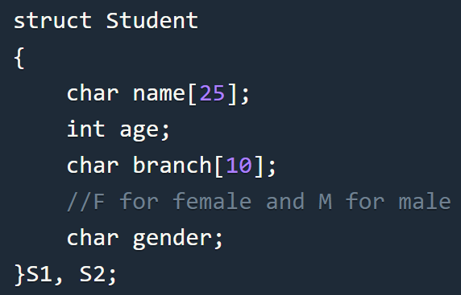
2) Declaring Structure variables with structure definition
Here S1 and S2 are variables of structure Student.

Slide 11
Accessing Structure Members
Structure members can be accessed and assigned values in a number of ways.
Structure members have no meaning individually without the structure.
In order to assign a value to any structure member, the member name must be linked with the structure variable using . Operator (dot) .. member access operator

Slide 12
Accessing Structure Members
#include<stdio.h>
#include<string.h>
struct Student
{
char name[25];
int age;
char branch[10];
char gender;
};
int main()
{
struct Student s1;
s1.age = 18;
strcpy(s1.name, "Viraaj");
printf("Name of Student 1: %s\n", s1.name);
printf("Age of Student 1: %d\n", s1.age);
return 0;
}

Slide 13
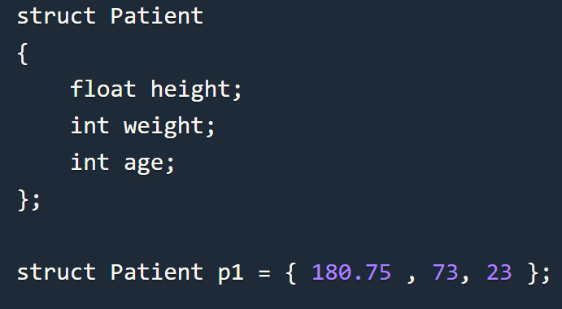
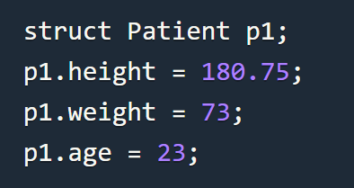
Structure Initialization
Like a variable of any other datatype, structure variable can also be initialized at compile time.
OR

Slide 14
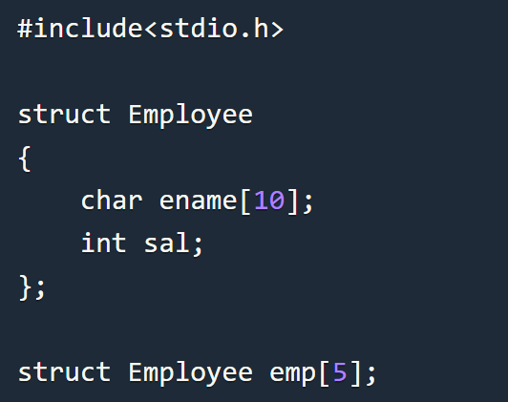
Array of Structure
We can also declare an array of structure variables. in which each element of the array will represent a structure variable.
Example: struct employee emp[5];
The below program defines an array emp of size 5. Each element of the array emp is of type Employee

Slide 15
Array of Structure
Program

Slide 16
Structure as Function Arguments
We can pass a structure as a function argument just like we pass any other variable or an array as a function argument.
Example

Slide 17


Pointers to Structures
You can define pointers to structures in the same way as you define pointer to any other variable −
You can store the address of a structure variable in the above defined pointer variable. To find the address of a structure variable, place the '&'; operator before the structure's name as follows

Slide 18

Pointers to Structures
You can define pointers to structures in the same way as you define pointer to any other variable −
To access the members of a structure using a pointer to that structure, you must use the → operator as follows

Slide 19
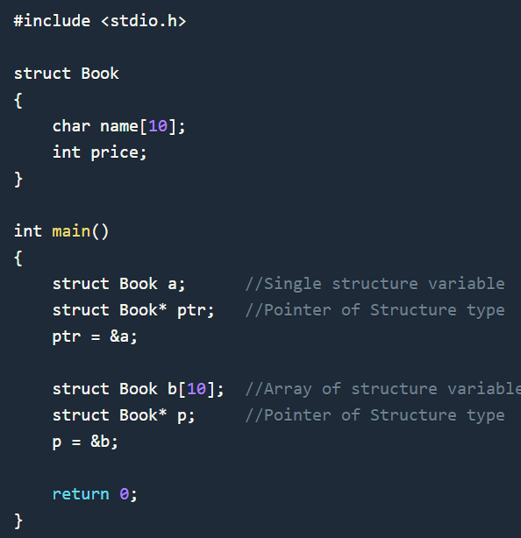
Pointers to Structures

Slide 20
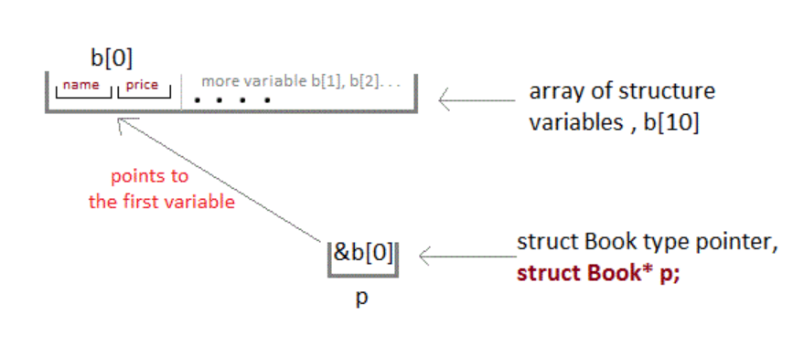
Pointers to Structures

Slide 21
Accessing Structure Members with Pointer
To access members of structure using the structure variable, we used the dot . operator.
But when we have a pointer of structure type, we use arrow -> to access structure members.

Slide 22
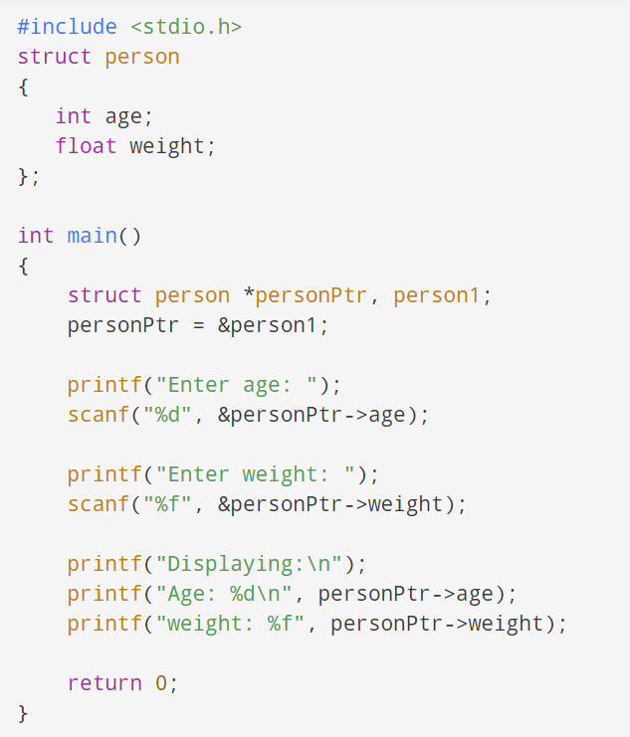
Accessing Structure Members with Pointer

Slide 23
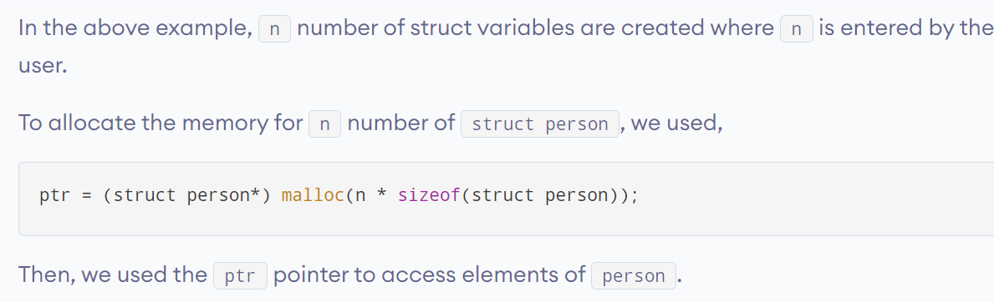
Dynamic memory allocation of structs
Sometimes, the number of struct variables you declared may be insufficient. You may need to allocate memory during run-time. Here's how you can achieve this in C programming.

Slide 24
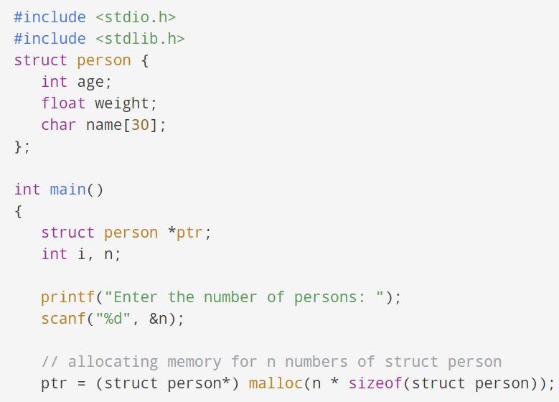
Dynamic memory allocation of structs

Slide 25
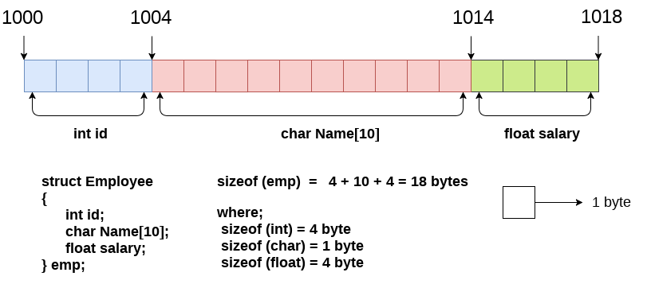
Structures: memory requirement

Slide 26
Use of typedef with structs
typedef is a powerful tool that allows programmers to define and then use their own data types. For example:
typedef int Integer;
Integer nStudents, nCourses, studentID;
Note that in the typedef statement, the newly defined type name goes in the place where a variable name would normally go.
There are a few benefits of using typedef with simple types such as the example above:
For readability, "Integer" may be easier to understand than "int".
The typedef can be easily changed later, ( say to "typedef long int Integer;"), which would then affect all variables of the defined type.

Slide 27
Use of typedef with structs
typedef struct Student {
int nClasses;
char name [ 20 ];
double gpa;
} Student;
Now that struct Student has been typedefed to the name "Student", additional variables of the same type can also be created:
Student phil, georgina;

Slide 28
Unions
A union is a special data type available in C that allows to store different data types in the same memory location.
You can define a union with many members, but only one member can contain a value at any given time.
Unions provide an efficient way of using the same memory location for multiple-purpose.
To define a union, you must use the union statement in the same way as you did while defining a structure

Slide 29
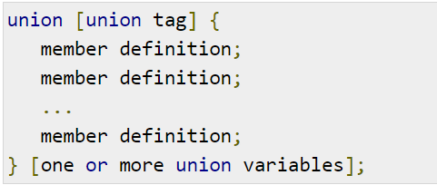
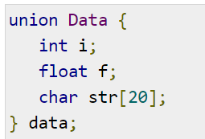
Unions

Slide 30
Unions
Now, a variable of Data type can store an integer, a floating-point number, or a string of characters.
It means a single variable, i.e., same memory location, can be used to store multiple types of data.
You can use any built-in or user defined data types inside a union based on your requirement.

Slide 31
Unions
The memory occupied by a union will be large enough to hold the largest member of the union.
For example, in this example, Data type will occupy 20 bytes of memory space because this is the maximum space which can be occupied by a character string.

Slide 32
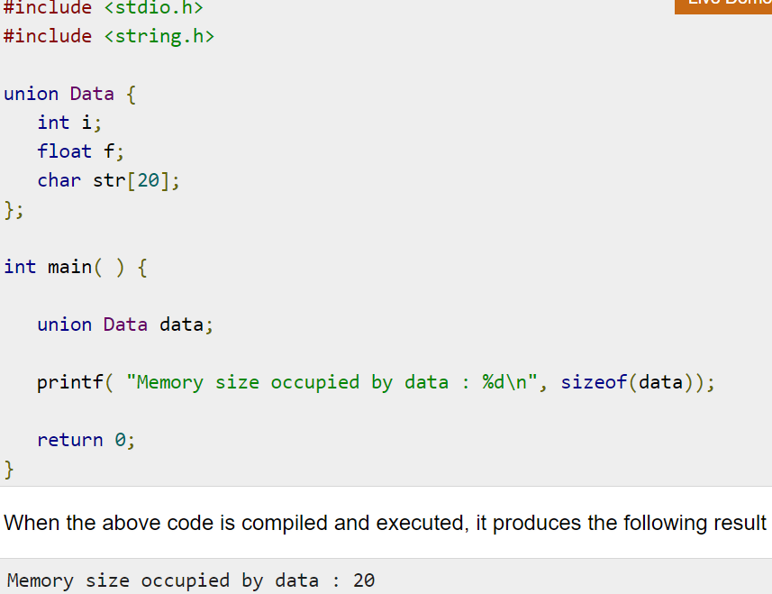
Unions

Slide 33
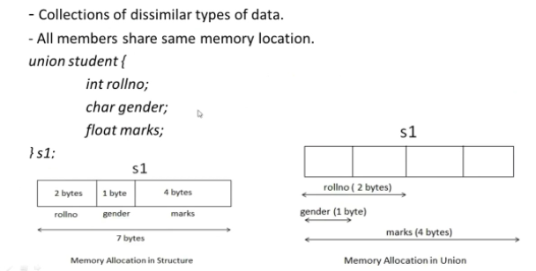
Difference Between Structure & Union

Slide 34
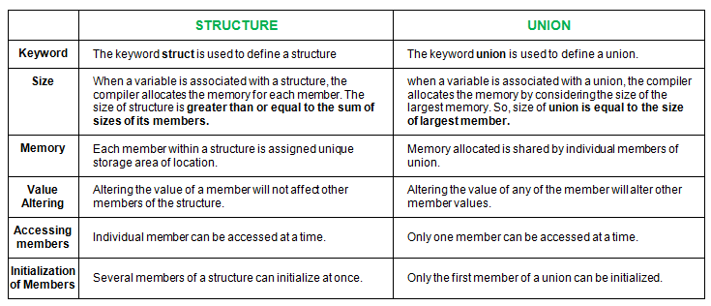
Difference Between Structure & Union

Slide 35
Thank You

